Slide 1
Safety and Reliability in Operations “It’s More Complex than you Think”
Deborah Grubbe, PE, CEng
President and Owner
Operations and Safety Solutions, LLC
FOCAPO 2012

Slide 2
Safety Contact - a Personal Operation
Used with permission-DuPont

Slide 3
Main Messages
Technology can be helpful in reducing operational risk
Technology, wrongfully applied, can introduce more risk
Decisions must be taken by those who understand the entire supply chain
Think narrowly AND broadly

Slide 4
Our Roadmap
BIG Business Case – viable and secure
Understanding and Managing Risk
Smart Operations – Sustainable and safe
Process Safety Management - 4 areas
Summary

Slide 5
BIG Business
The US is the number one manufacturing nation in the world; imports are key
The US is the world’s number one services exporter and has been since services trade data have been tracked.
95 percent of the world’s consumers lives outside the United States…as do 95 percent of the world’s workers.
Trade supports 38 million jobs in the United States–more than one in five American jobs in retail, research, design, sourcing, transportation, warehousing, marketing and sales…and in manufacturing.
John Murphy, U.S. Chamber of Commerce, Jan 5, 2010
Dan Ikenson, Forbes Magazine, Jan 6, 2011

Slide 6
BIG Waste
Thousands of lives are lost in preventable incidents in the US alone (4574 in 2010)
Billions are lost every year due to injuries/incidents
In the chemical industry, PSM has been in place for over 20 years, but we are still learning? Why is this?
Why do we never have time and money to do the work up front, but always have the time and money to study it afterwards?
Do executive teams truly understand their risk profile?

Slide 7
OSHA’s Top 8 for 2011
Excavation
Fall Protection
Process Safety Management
Grain Handling Facilities
Asbestos
Lockout/Tag-out
Machine Guarding
Special Excavation Requirements

Slide 8
Where leaders got risk wrong……
Union Carbide - Bhopal
Occidental in the North Sea - Piper Alpha
Nuclear Industry - TMI and Chernobyl
NASA – Challenger and Columbia
TEPCO – Fukushima (in progress)
BP - Texas City, Deepwater Horizon (in progress)

Slide 9
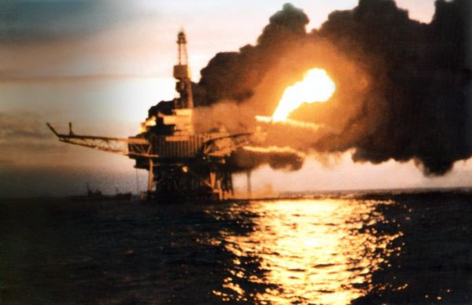
Occidental – Piper Alpha
168 dead
Communications

Slide 10
Chernobyl
Millions relocated
125K dead, estimated
USD 200 billion
Bypassed safety systems
@ 0100 hrs on holiday weekend
Technical support absent

Slide 11
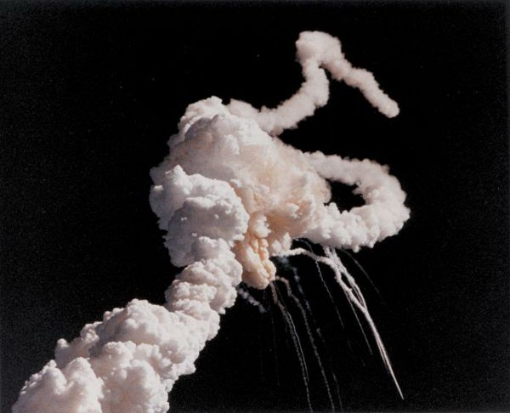
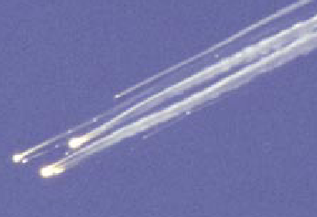
NASA Challenger & Columbia
15 dead
Billions spent
Risk estimation
Communications
“Space is easy”
Mantra Management

Slide 12
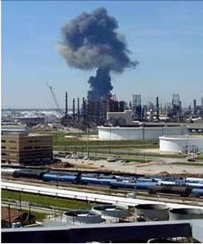
BP Texas City
15 dead
170 injured
USD 8 billion
Containment
Communications

Slide 13
Managing Risk
Via standard – mostly
frequency reduction
Demonstrate continuous risk reduction via hazard ID/reduction
Decreasing frequency
Line of “Pain”
Via measures – mostly consequence reduction
The land of ZERO
Decreasing consequence

Slide 14
Vision for Future Operations
SMART and safe
Zero injuries, zero waste
Sustainable, Efficient, Effective
Optimized all along supply chain
Demand driven, 100% made to order

Slide 15
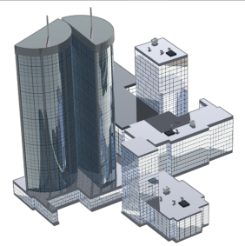
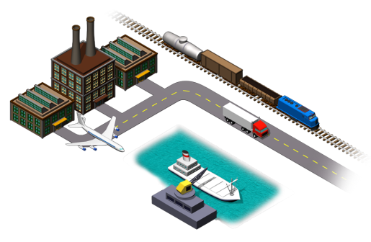
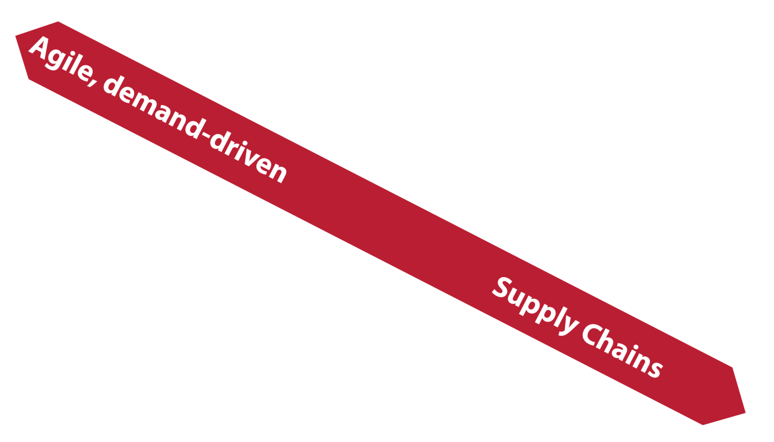
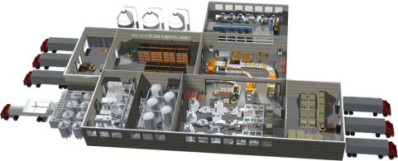
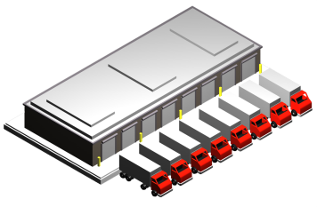
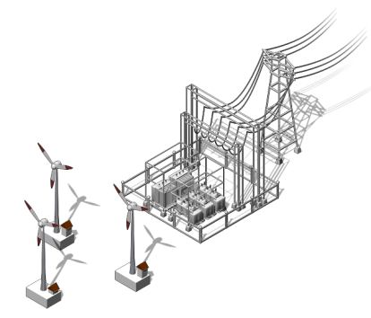
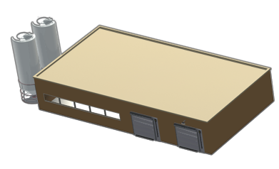
Optimized Plant & Supply Network: Technology Trends
Combined product-process design
Advanced process control
Flexible, modular automation
Enterprise
Business
System
Suppliers
Integrated safety solutions
Smart devices with energy monitoring
Waste & emissions optimization
Modeling and simulation
Unified information between plant & enterprise
Production optimization to meet real-time global customer demand
Factory
Distribution
Center
Smart Grid
Secure Ethernet
Wireless
Customer
OEM
Machine
Builders
Copyright © 2009 Rockwell Automation, Inc. All rights reserved.
15

Slide 16
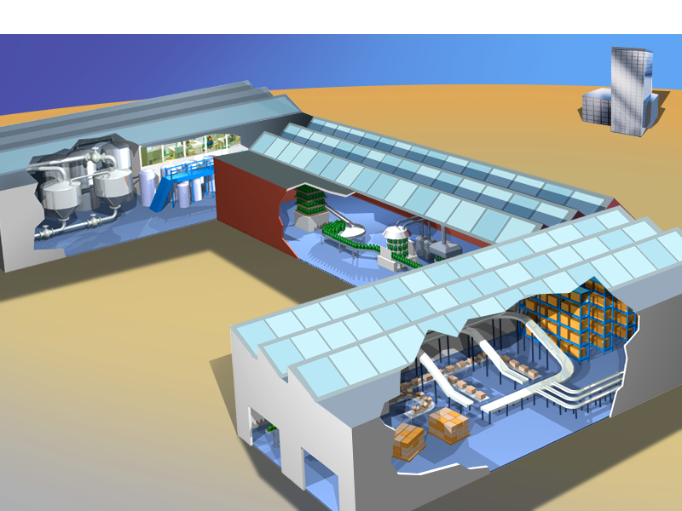
Manufacturing Today: Islands of Efficiency
Batch
Continuous
Motion
Drive
Energy-efficient
Motors
Combined
Heat &
Power
(CHP)
Distributed
Control
Systems
(DCS)
Smart
Machines
& Robots
Discrete
Safety
Programmable
Logic
Controllers
(PLC)
Most plants use multiple separate manufacturing control and information technologies
Copyright © 2009 Rockwell Automation, Inc. All rights reserved.
16
Notes:
16
So what is this transformation to Smart Manufacturing that will bring the next era of industrial innovation?
The first phase of it began about 20 to 30 years ago as multiple new manufacturing technologies improved efficiency in the many separate cells of a typical factory.
Computers began controlling production processes whether it was making chemicals, cars or cereal.
Smart machines and energy-efficient motors began to drive assembly lines.
And highly automated packaging prepared products for delivery out the door.
Today, to transform manufacturing, we need to connect these islands of efficiency together and more importantly, make it all work together to enable the next generation of smart manufacturing…

Slide 17
Smart Manufacturing 1.0: Plant-wide Optimization
Industrial
Energy
Management
Batch
Continuous
Motion
Drive
Discrete
e.g., Ethernet/IP
Safety
Networked sensors
Data interoperability standards
Systems communications standards
Automated control systems
Data fusion
Production management software suite
End-to-end control and information connectivity across the plant floor
Copyright © 2009 Rockwell Automation, Inc. All rights reserved.
17
Notes:
17
Literally connecting all the intelligent motors and sensors together with the smart machines, computers and other smart hardware and software across the factory floor is the first step in creating what we call the connected enterprise.
Numerous benefits occur when you connect the entire manufacturing plant together, such as with Ethernet/IP networking technology.
For example, it will enable the first real-time industrial energy management system. As Dr. Neal Elliott from ACEEE estimates, there will be twice the energy savings from this transformation in the next 20 years compared to energy savings in the past 20 years.
The complete integration of load management, demand response, and energy efficiency across an entire industrial plant is within reach in the next decade.
With smart manufacturing technology, manufacturers will also be able to measure and manage carbon footprints for each product line in the future and put that information on each package if consumers want it.

Slide 18
Optimize Production Costs, Quality, Safety, Efficiency 2015 Objectives
Data capture with a standard “Universal ID Code” for all product bills of materials and any resources used in the production process
Network sensors in massive numbers throughout manufacturing plants and surrounding environments to provide production data.
Data interoperability standards provides the ability to seamlessly exchange electronic product, process and project data between collaborating groups or companies and across design, construction, maintenance and business systems.
Standard communications networks enable plant-wide data collection and communication across the factory floors and supply chain.
Automated control systems are the workhorse of the production processes and begin data transformation into dynamic information.
Data fusion and information integration create the useful, accessible knowledge that is essential in a network-centric manufacturing environment.
Production Software enables long- and short-term planning; predictive control; optimization; environmental, health and safety management; and other intelligence about manufacturing operations.
18

Slide 19
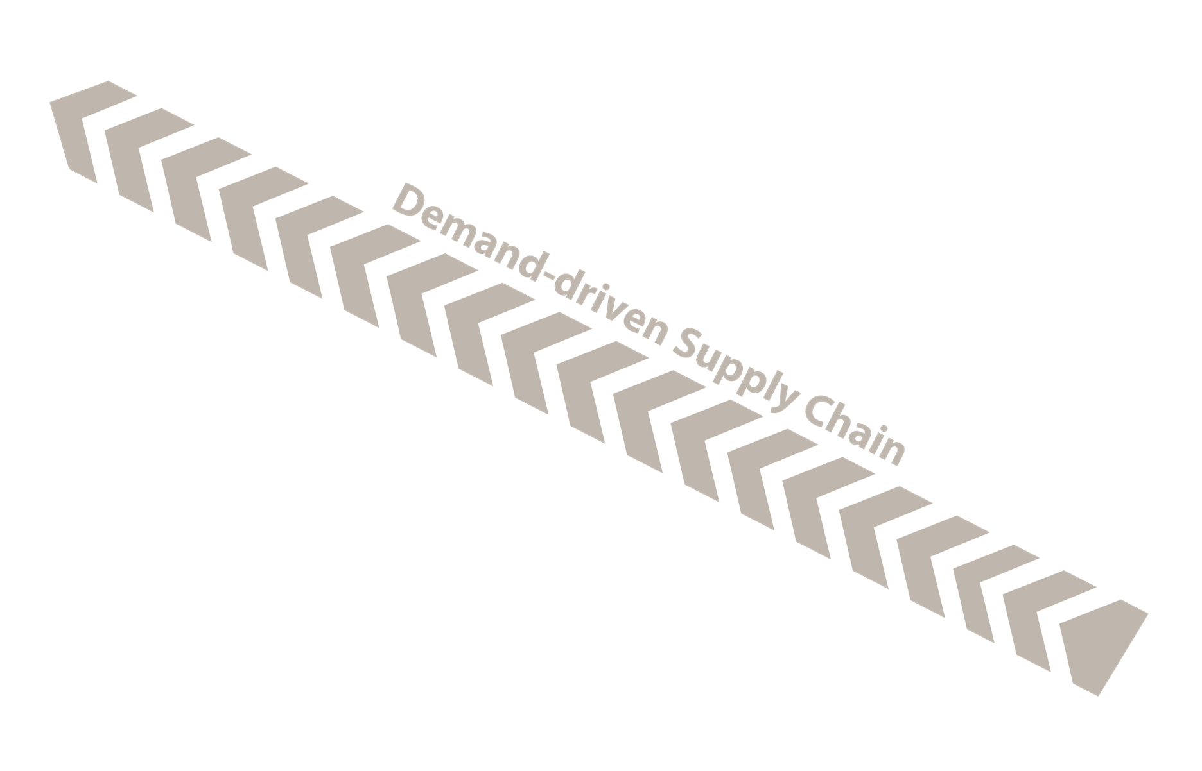
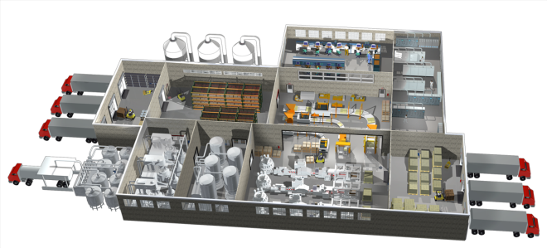
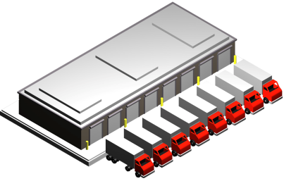
Highly-optimized Production & Demand-driven Supply Chain Efficiency
Customers “pushing” demands
Flexible production of smaller
volumes of custom products
Less vertically integrated
More information driven and automated
Mining
Farming
Supply Chain
Efficiency Metrics
for the next hundred years will be a “closed loop equation” with measures like customization, flexibility, information flow, responsiveness and reuse
Manufacturing Plant
Distributor
Copyright © 2009 Rockwell Automation, Inc. All rights reserved.
Customer

Slide 20
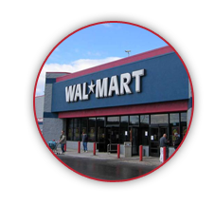
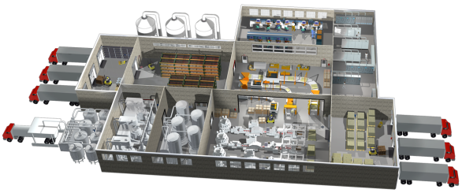
What’s Different about Highly-optimized Plants and Dynamic, Demand-driven Supply Networks?
Distributors, like Walmart, already demand that manufacturers own and manage inventory in their stores.
Mining
Farming
Supply Chain
Manufacturing Plant
Information Flow:
ICT is reversing relationships
by increasing the transparency of
data up the supply chain such as inventories
and someday total business operations
Distributor
Customer
Copyright © 2009 Rockwell Automation, Inc. All rights reserved.
20

Slide 21
DuPont
Process Safety and Risk Management Model
Process
Technology
Auditing
Operating
Procedures and Safe
Practices
Emergency Planning
and Response
Management of Change
Management of
Change
Incident Investigation
and Reporting
MANAGEMENT
LEADERSHIP &
COMMITMENT
Process Hazards
Analysis
Contractor Safety
and Performance
Training and
Performance
Quality Assurance
Management of
“Subtle” Change
Prestart-Up Safety
Reviews
Mechanical Integrity
Copyright © 2010 E.I. du Pont de Nemours, Inc. All rights reserved.

Slide 22
Areas of Process Safety Management
Values, Beliefs, Ops Discipline
Contractor management
Safety Instrumented Systems
Preventive and Predictive Maintenance
Operating Envelopes and Parameters
Reactive Chemistry
Training of your entire workforce
Communications
Lock, Tag, Clear and Try
Integrity, corrosion, erosion of all equipment

Slide 23
Forward Actions
Don’t forget the Human! – a key component of all systems
Get senior management involved in technology decisions, their very jobs may depend on it
Seek out those who think differently

Slide 24
Questions?
deb@opsandss.com

